Slide 1
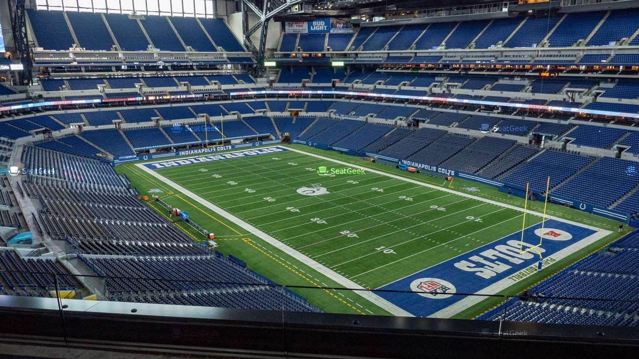

Lucas Oil Stadium Development/Impact
Brandon Whitmore
SM 313 002
Winter 2020
This Photo by Unknown Author is licensed under CC BY-SA

Slide 2
Step 1
Venue: Lucas Oil Stadium; Indianapolis, IN
Construction begins January 2020
Duration: 30 months
Estimated completion: June 2022
This Photo by Unknown Author is licensed under CC BY-SA

Slide 3
Step 2
Total Cost: $720 million¹ ($843 million in 2018 dollars)²
There was no additional real estate development with the project.
¹ "Facts and Information". Lucas Oil Stadium. 2008. Retrieved February 3, 2020.
²Thomas, Ryland; Williamson, Samuel H. (2019). "What Was the U.S. GDP Then?". MeasuringWorth. Retrieved February 3, 2020.
This Photo by Unknown Author is licensed under CC BY-SA

Slide 4
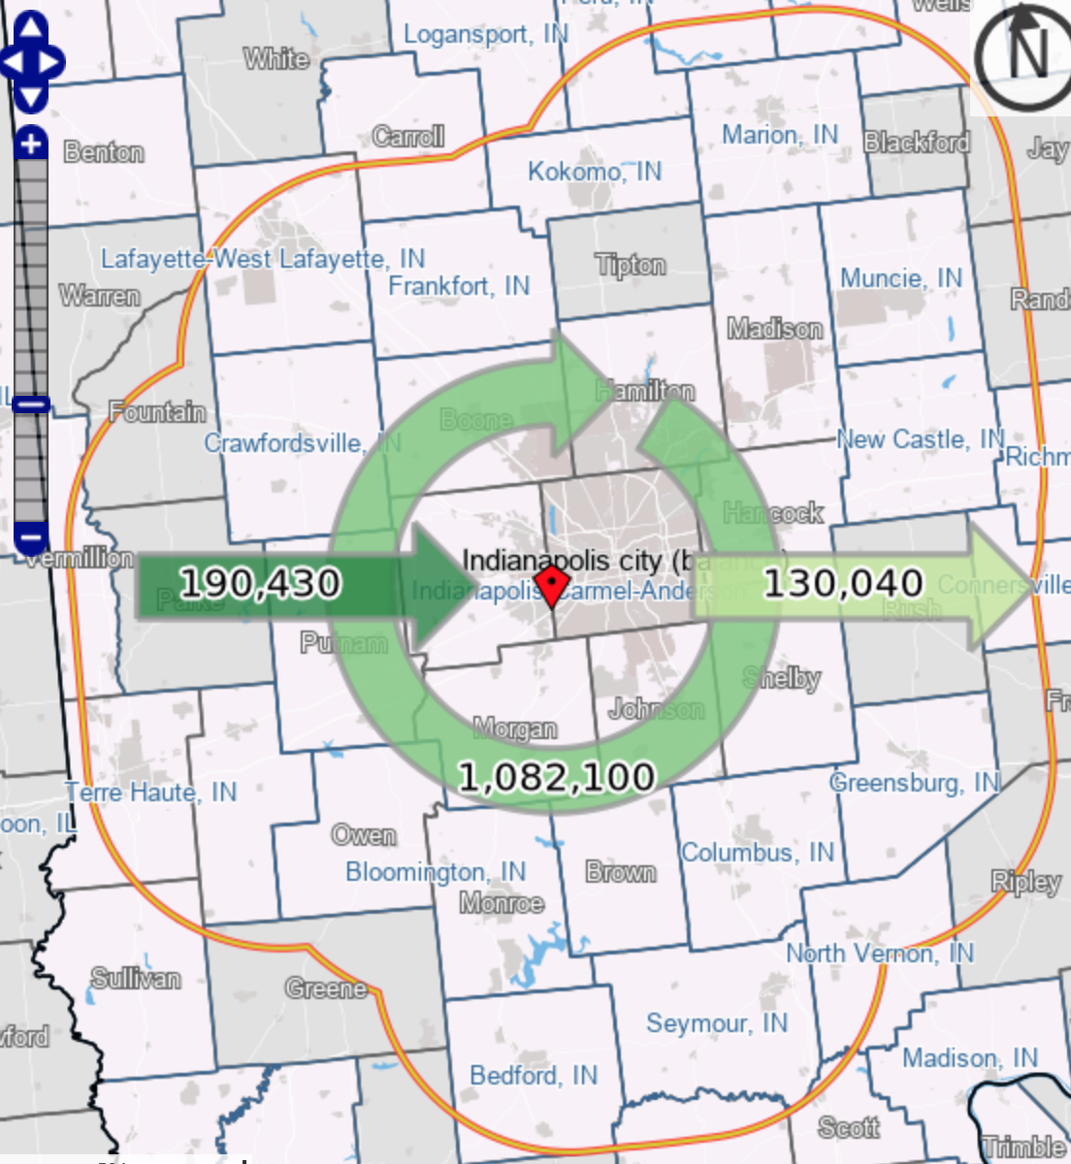
Step 3
The commute shed includes the radius of about 25 miles from Indianapolis DMA (shown in the figure to the right).³ On average, the average commute within the DMA is 25 minutes.⁴ It was estimated many of the roads drivers would have to drive to get into work were between 50 and 70 mph, so the average of 60 mph was taken to find the distance of 25 miles.
³Indianapolis DMA. (n.d.). Retrieved February 3, 2020, from https://onthemap.ces.census.gov/
⁴Average Commute to Work Indianapolis MSA. (n.d.). Retrieved February 4, 2020, from https://www.socialexplorer.com/tables/ACS2018_5yr/R12444553
.
This Photo by Unknown Author is licensed under CC BY-SA

Slide 5
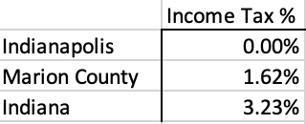
Step 4
Indianapolis, Marion County, and Indiana had no extra taxes necessary for this project on its residents other than on income. The tax rates are listed below.⁵
⁵Indiana Income Tax Calculator. (n.d.). Retrieved February 3, 2020, from https://smartasset.com/taxes/indiana-tax-calculator
This Photo by Unknown Author is licensed under CC BY-SA

Slide 6
Step 5
The stadium is owned by the city, making it exempt from the local property taxes.
This Photo by Unknown Author is licensed under CC BY-SA

Slide 7
Step 6
The split between labor and materials is 33%/67%. Going off the $720 million, labor would cost $240 million while materials would cost $480 million.
This Photo by Unknown Author is licensed under CC BY-SA

Slide 8
Step 7
As of November 2019, the unemployment rate in the Marion County was 3.1%.⁶ I would assume the economic impact would be negative based on the unemployment rate. The rate is lower than normal and the national average. The labor supply would be lower than normal for hiring additional workers, and the project would give fewer new jobs as a result.
⁶U.S. Bureau of Labor Statistics, Unemployment Rate in Marion County, IN [INMARI0URN], retrieved from FRED, Federal Reserve Bank of St. Louis; https://fred.stlouisfed.org/series/INMARI0URN, February 4, 2020..
This Photo by Unknown Author is licensed under CC BY-SA

Slide 9
Step 8 Assumptions
10% architecture rate per Professor Rosentraub (leakage)
15% of the remaining $168 million labor cost comes from outside the Marion County economy per Professor Rosentraub (leakage)
All material money stays within county. Concrete is a local product, and while steel and other materials probably came from outside the county, there is very little credible data to suggest a good estimate (no leakage)

Slide 10
Step 8

Slide 11

Step 8
Total Investment staying in Marion County in $2020 is found by taking the future value of the Total Investment staying in Marion County using the CPI.⁷
⁷CPI Index 2008-2019. (n.d.). Retrieved February 4, 2020, from https://data.bls.gov/pdq/SurveyOutputServlet

Slide 12
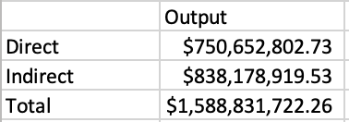
Step 8
The total impact was determined by multiplying the multiplier of 2.1166 with the Total Investment staying in Marion County in $2020.
This Photo by Unknown Author is licensed under CC BY-SA

Slide 13
Step 8
To get the present value of the impact over 30 months, the projected interest rate of 2.5% is used based on bank mortgage loans.
This Photo by Unknown Author is licensed under CC BY-SA

Slide 14
Step 9
To find jobs created, the amount of labor staying in Marion County is divided by the average annual construction worker salary. The average salary for a construction worker in Indiana is $38,380.⁸
⁸Indiana - May 2018 OES State Occupational Employment and Wage Estimates. (2019, April 2). Retrieved February 4, 2020, from https://www.bls.gov/oes/2018/may/oes_in.htm#47-0000
This Photo by Unknown Author is licensed under CC BY-SA

Slide 15
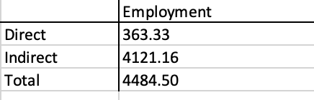
Step 9
Direct Jobs are found by taking the product of the multiplier for direct employment of 2.1110 and the Labor Cost Staying in $2020 and dividing it by $1 million. Indirect jobs are found by taking the difference between Total Workers (jobs) and the Direct Jobs as shown below.
⁸Indiana - May 2018 OES State Occupational Employment and Wage Estimates. (2019, April 2). Retrieved February 4, 2020, from https://www.bls.gov/oes/2018/may/oes_in.htm#47-0000
This Photo by Unknown Author is licensed under CC BY-SA

Slide 16
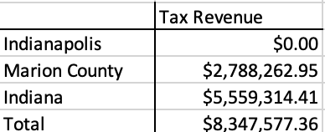
Step 10
The tax revenues generated are found by multiplying the tax rates from Step 4 by the average construction worker salary and the number of new jobs created determined in Step 9. The average salary of a construction worker in Indiana is $38,380 as determined in Step 8. The tax revenue is calculated below.
This Photo by Unknown Author is licensed under CC BY-SA

